Slide 1

Housing Price Project
Submitted by: Sapna Jolly

Slide 2


Introduction
Housing Price Prediction Project
Houses are one of the necessary need of each and every person around the globe and therefore housing and real estate market is one of the markets which is one of the major contributors in the world’s economy. The main objective of this project is to build a model to predict the price of the houses based on the features mentioned in the dataset.

Slide 3

Business Problem Framing
We are required to model the price of houses with the available independent variables. This model will then be used by the management to understand how exactly the prices vary with the variables. They can accordingly manipulate the strategy of the firm and concentrate on areas that will yield high returns. Further, the model will be a good way for the management to understand the pricing dynamics of a new market.

Slide 4
Dataset Information
Shape
Data contains 1168 entries each having 81 variables
Null Values
The dataset contains missing values (null values). We need to handle that.
Problem Statement
We need to build model to predict the sale price of the houses. We are using regression techniques.

Slide 5
Conceptual Backgroud of the Domain Problem
Houses are one of the necessary need of each and every person around the globe and therefore housing and real estate market is one of the markets which is one of the major contributors in the world’s economy. It is a very large market and there are various companies working in the domain. Data science comes as a very important tool to solve problems in the domain to help the companies increase their overall revenue, profits, improving their marketing strategies and focusing on changing trends in house sales and purchases. Predictive modelling, Market mix modelling, recommendation systems are some of the machine learning techniques used for achieving the business goals for housing companies. Our problem is related to one such housing company.
A US-based housing company named Surprise Housing has decided to enter the Australian market. The company uses data analytics to purchase houses at a price below their actual values and flip them at a higher price. For the same purpose, the company has collected a data set from the sale of houses in Australia.

Slide 6
Data Description
S. No. | Variable | Defination
1 | MSSubClass | Identifies the type of dwelling involved in the sale.
2 | MSZoning | Identifies the general zoning classification of the sale.
3 | LotFrontage | Linear feet of street connected to property
4 | LotArea | Lot size in square feet
5 | Street | Type of road access to property
6 | Alley | Type of alley access to property
7 | LotShape | General shape of property
8 | LandContour | Flatness of the property
9 | Utilities | Type of utilities available
10 | LotConfig | Lot configuration
11 | LandSlope | Slope of property
12 | Neighborhood | Physical locations within Ames city limits
13 | Condition1 | Proximity to various conditions
14 | Condition2 | Proximity to various conditions (if more than one is present)
15 | BldgType | Type of dwelling
16 | HouseStyle | Style of dwelling
17 | OverallQual | Rates the overall material and finish of the house
18 | OverallCond | Rates the overall condition of the house
19 | YearBuilt | Original construction date
20 | YearRemodAdd | Remodel date (same as construction date if no remodeling or additions)
S. No. | Variable | Defination
21 | RoofStyle | Type of roof
22 | RoofMatl | Roof material
23 | Exterior1st | Exterior covering on house
24 | Exterior2nd | Exterior covering on house (if more than one materi
25 | MasVnrType | Masonry veneer type
26 | MasVnrArea | Masonry veneer area in square feet
27 | ExterQual | Evaluates the quality of the material on the exterior
28 | ExterCond | Evaluates the present condition of the material on the exterior
29 | Foundation | Type of foundation
30 | BsmtQual | Evaluates the height of the basement
31 | BsmtCond | Evaluates the general condition of the basement
32 | BsmtExposure | Refers to walkout or garden level walls
33 | BsmtFinType1 | Rating of basement finished area
34 | BsmtFinSF1 | Type 1 finished square feet
35 | BsmtFinType2 | Rating of basement finished area (if multiple types)
36 | BsmtFinSF2 | Type 2 finished square feet
37 | BsmtUnfSF | Unfinished square feet of basement area
38 | TotalBsmtSF | Total square feet of basement area
39 | Heating | Type of heating
40 | HeatingQC | Heating quality and condition
41 | CentralAir | Central air conditioning
42 | Electrical | Electrical System

Slide 7
Data Description
S. No. | Variable | Defination
S. No. | Variable | Defination
43 | 1stFlrSF | First Floor square feet
44 | 2ndFlrSF | Second floor square feet
45 | LowQualFinSF | Low quality finished square feet (all floors)
46 | GrLivArea | Above grade (ground) living area square feet
47 | BsmtFullBath | Basement full bathrooms
48 | BsmtHalfBath | Basement half bathrooms
49 | FullBath | Full bathrooms above grade
50 | HalfBath | Half baths above grade
51 | Bedroom | Bedrooms above grade (does NOT include basement bedrooms)
52 | Kitchen | Kitchens above grade
53 | KitchenQual | Kitchen quality
54 | TotRmsAbvGrd | Total rooms above grade (does not include bathrooms)
55 | Functional | Home functionality (Assume typical unless deductions are warranted)
56 | Fireplaces | Number of fireplaces
57 | FireplaceQu | Fireplace quality
58 | GarageType | Garage location
59 | GarageYrBlt | Year garage was built
60 | GarageFinish | Interior finish of the garage
61 | GarageCars | Size of garage in car capacity
62 | GarageArea | Size of garage in square feet
63 | GarageQual | Garage quality
64 | GarageCond | Garage condition
65 | PavedDrive | Paved driveway
66 | WoodDeckSF | Wood deck area in square feet
67 | OpenPorchSF | Open porch area in square feet
68 | EnclosedPorch | Enclosed porch area in square feet
69 | 3SsnPorch | Three season porch area in square feet
70 | ScreenPorch | Screen porch area in square feet
71 | PoolArea | Pool area in square feet
72 | PoolQC | Pool quality
73 | Fence | Fence quality
74 | MiscFeature | Miscellaneous feature not covered in other categories
75 | MiscVa | $Value of miscellaneous feature
76 | MoSold | Month Sold (MM)
77 | YrSold | Year Sold (YYYY)
78 | SaleType | Type of sale
79 | SaleCondition | Condition of sale

Slide 8
Data Visualization

Slide 9
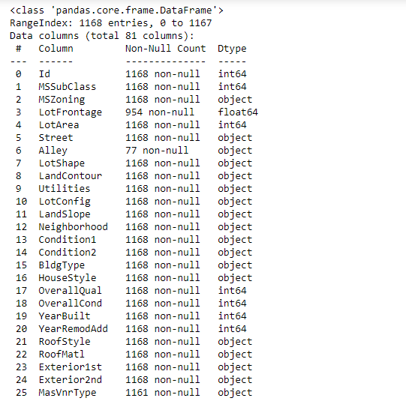
The data types of the dataset are mentioned below:
Enter Title

Slide 10
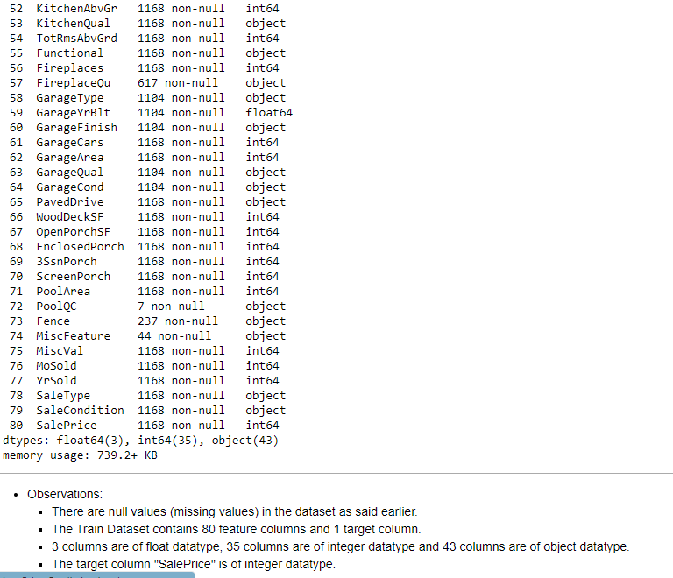

Slide 11
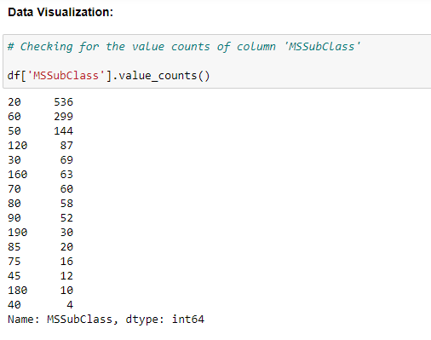

Slide 12
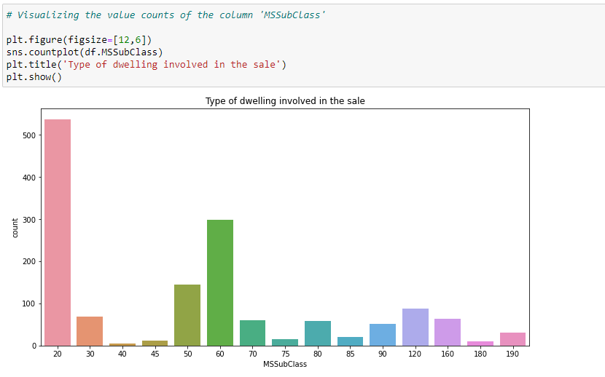

Slide 13
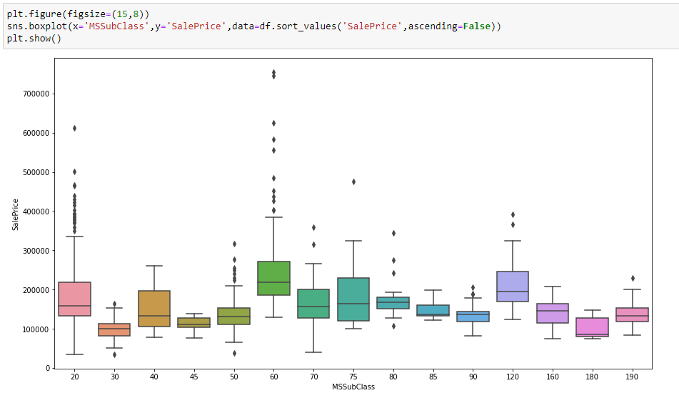

Slide 14
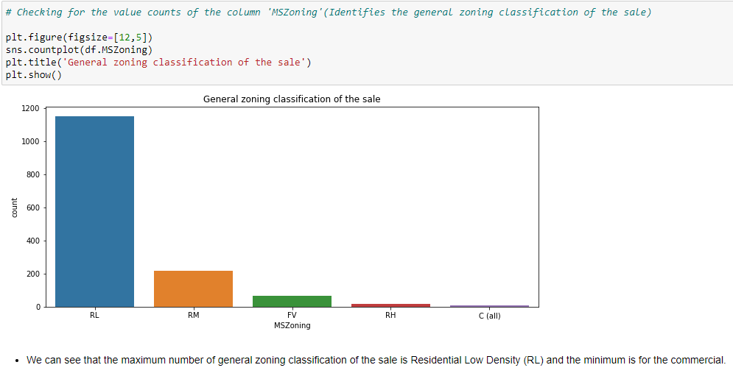

Slide 15
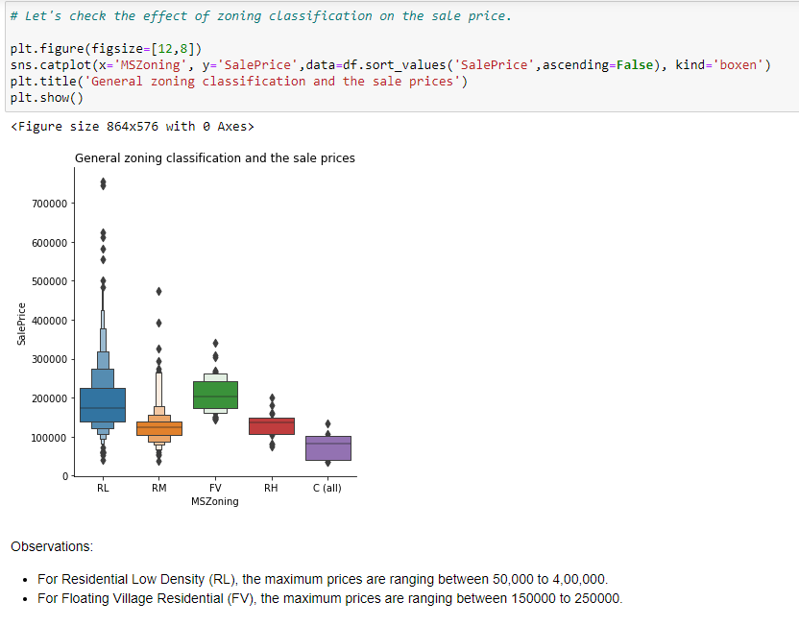

Slide 16
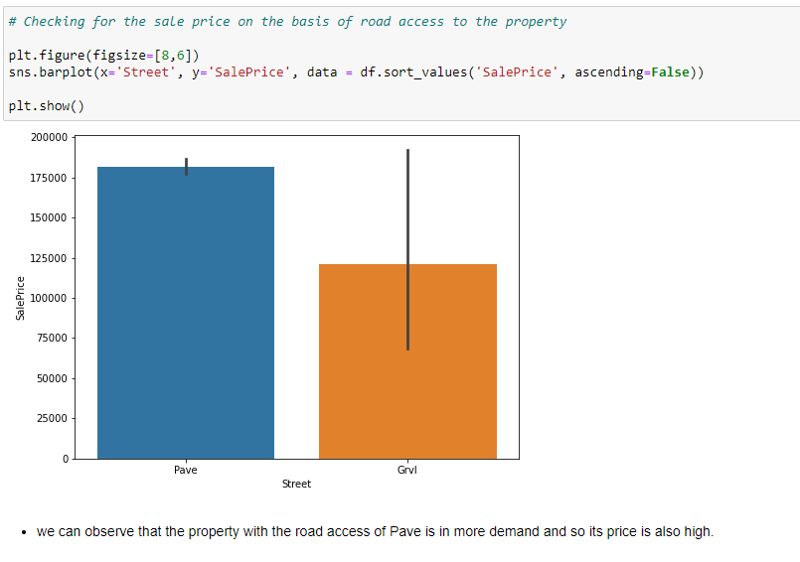

Slide 17
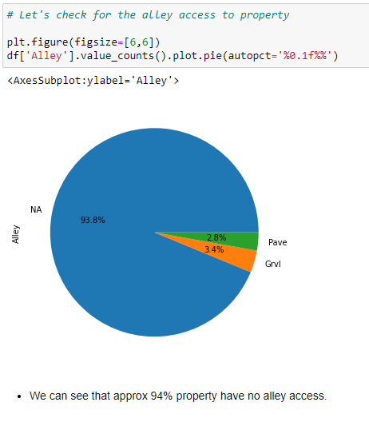
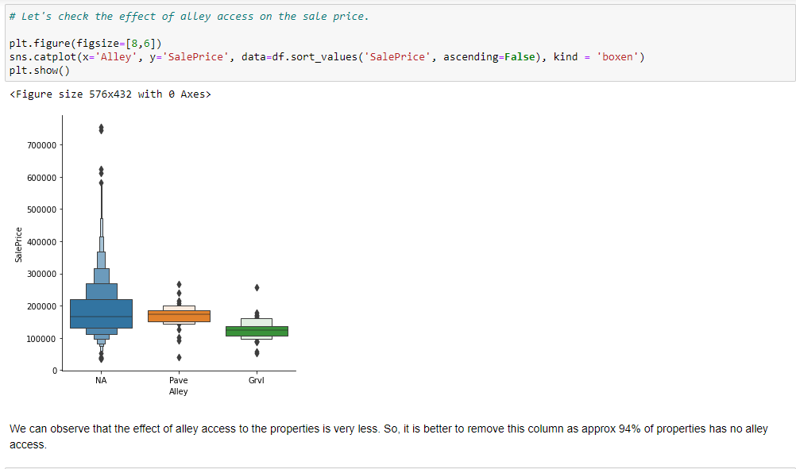

Slide 18
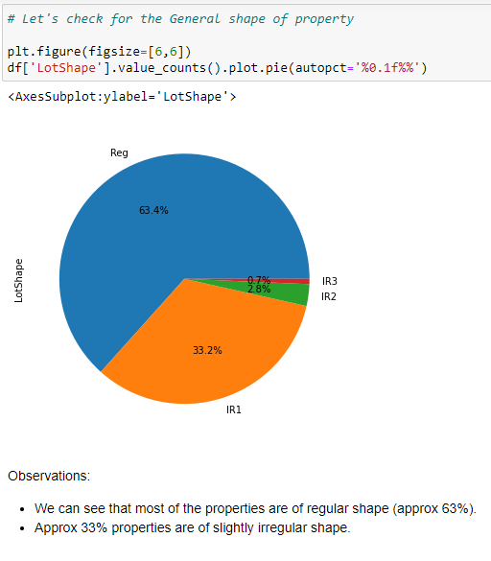
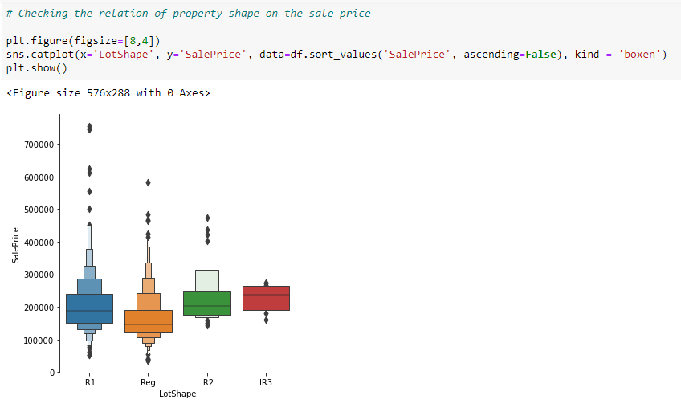

Slide 19
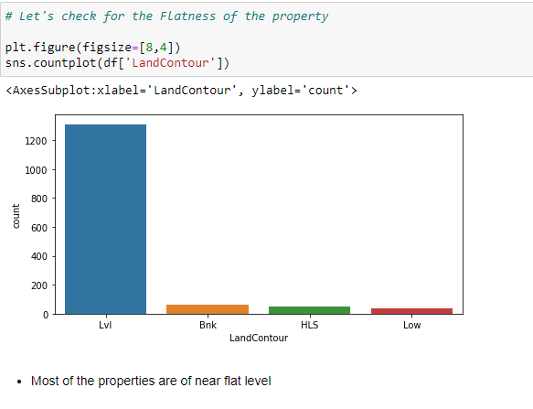
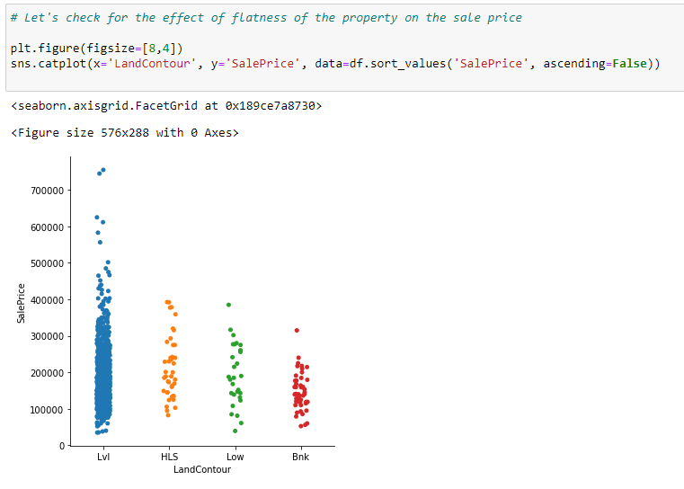

Slide 20
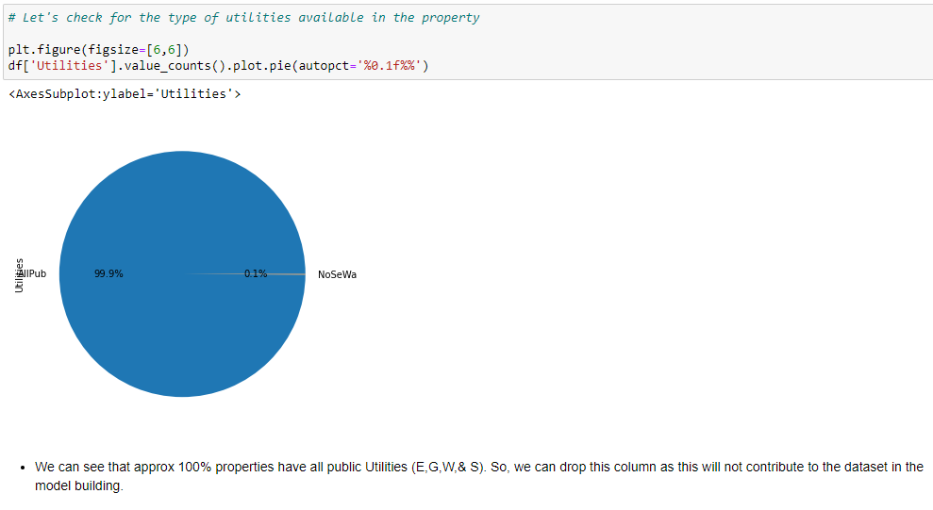

Slide 21
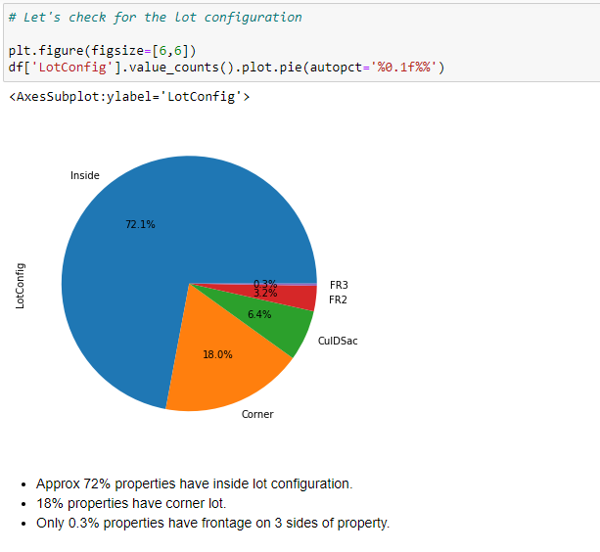

Slide 22
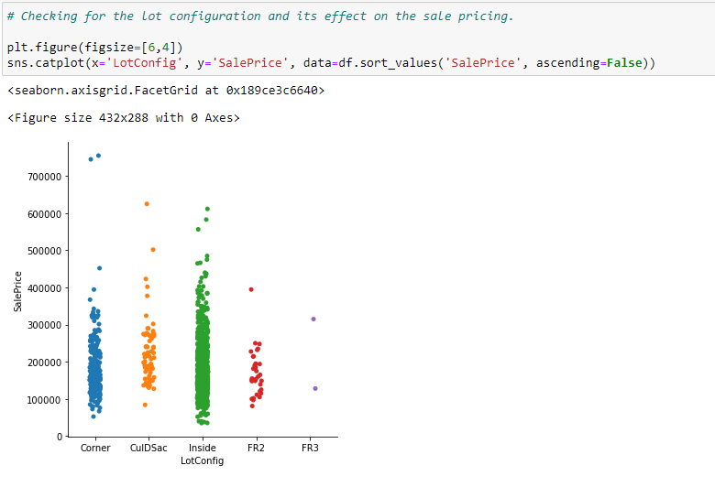

Slide 23
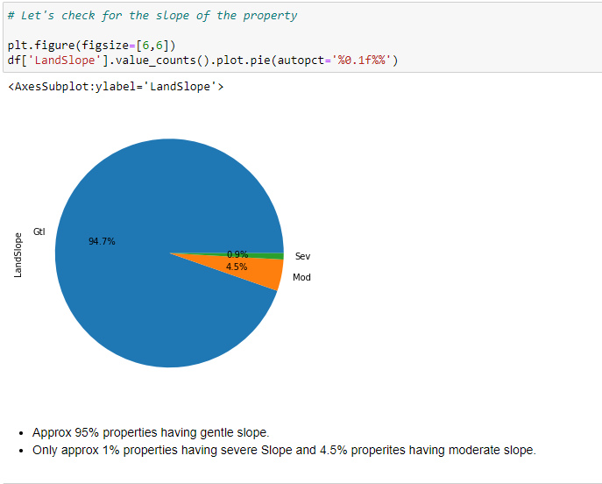

Slide 24
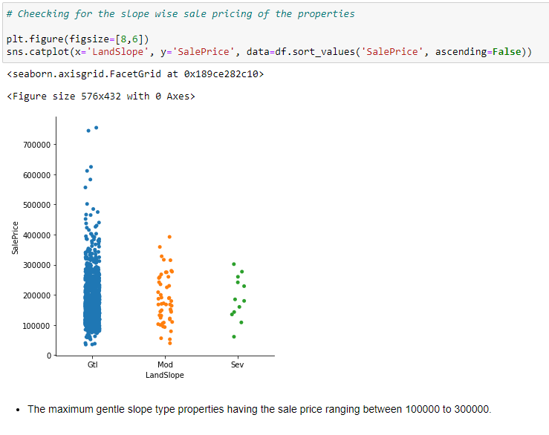

Slide 25
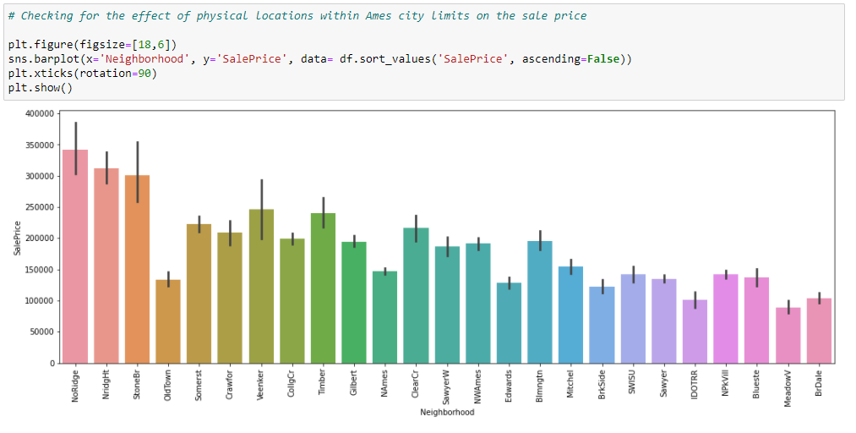

Slide 26
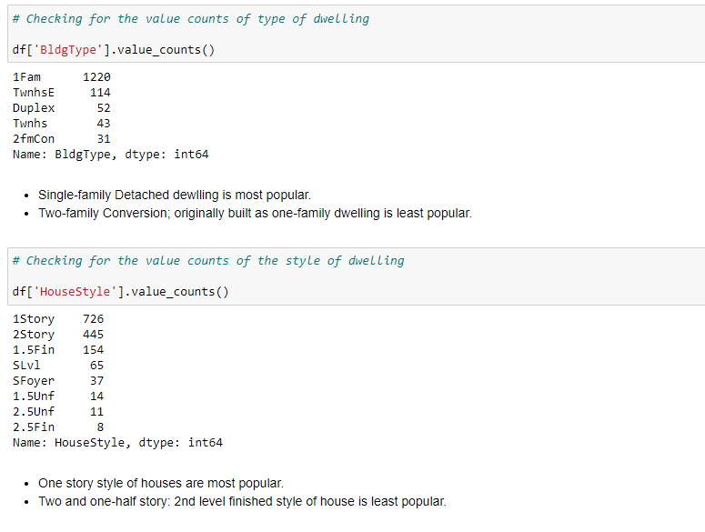

Slide 27
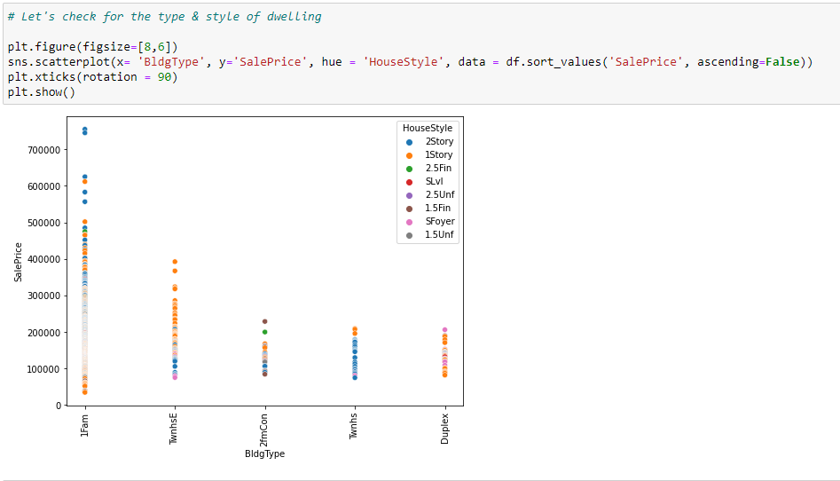

Slide 28
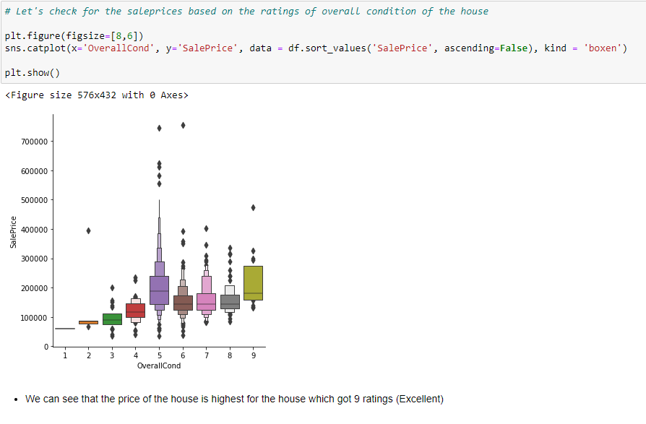

Slide 29
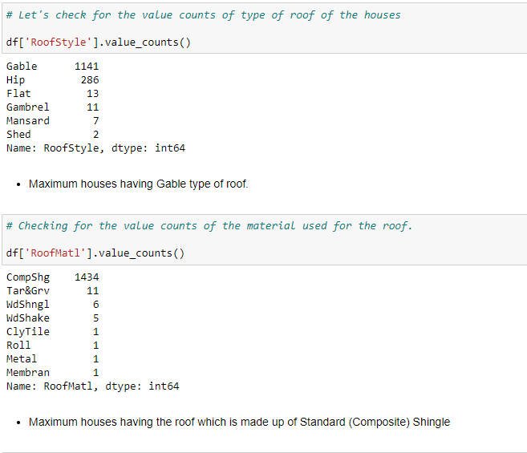

Slide 30
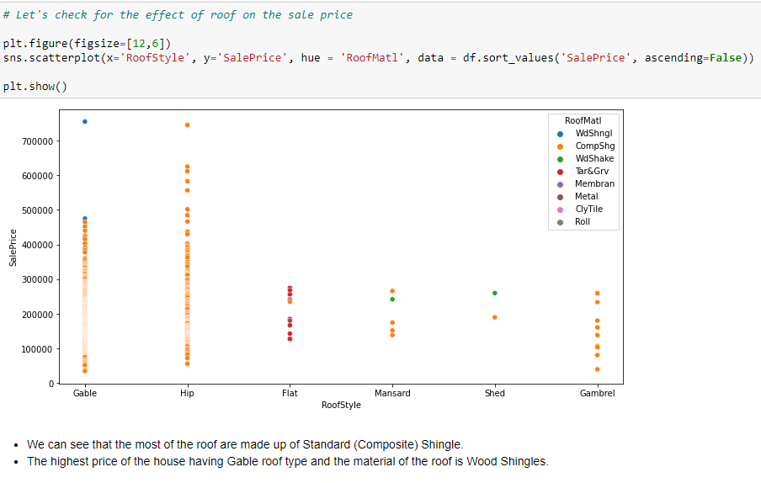

Slide 31
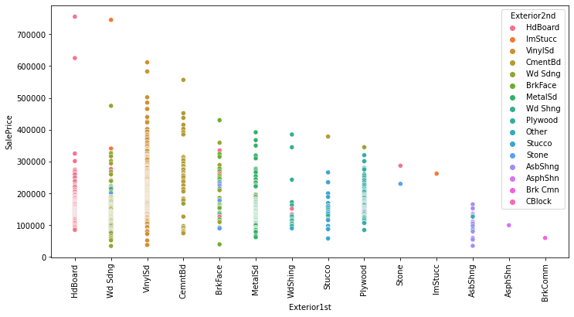

Slide 32
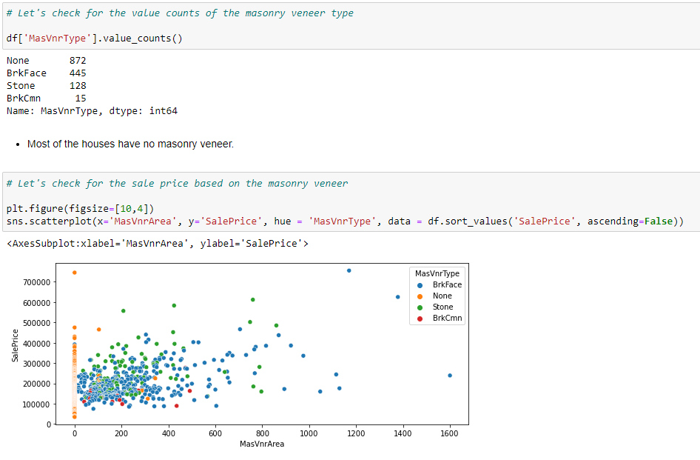

Slide 33
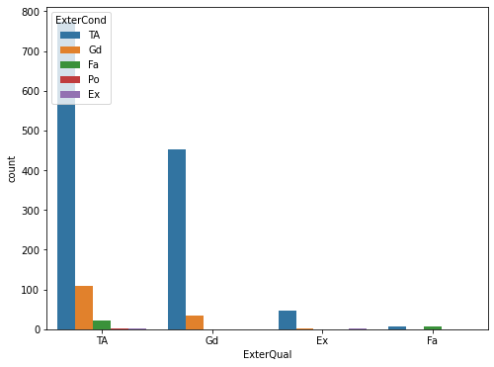
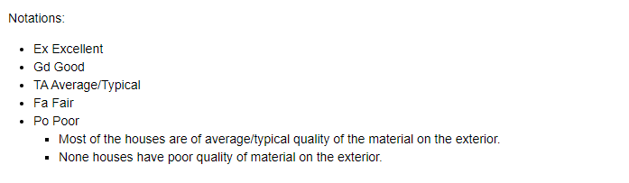

Slide 34
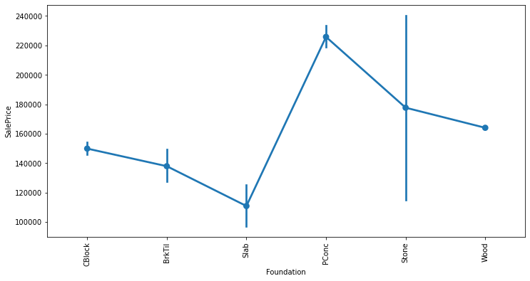

Slide 35
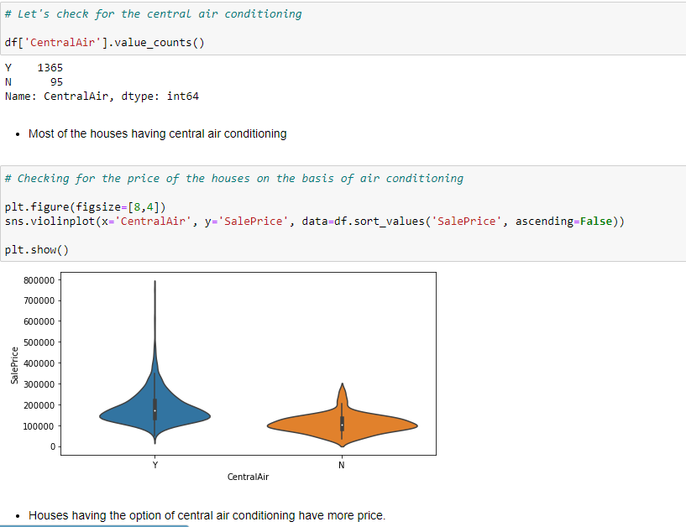

Slide 36
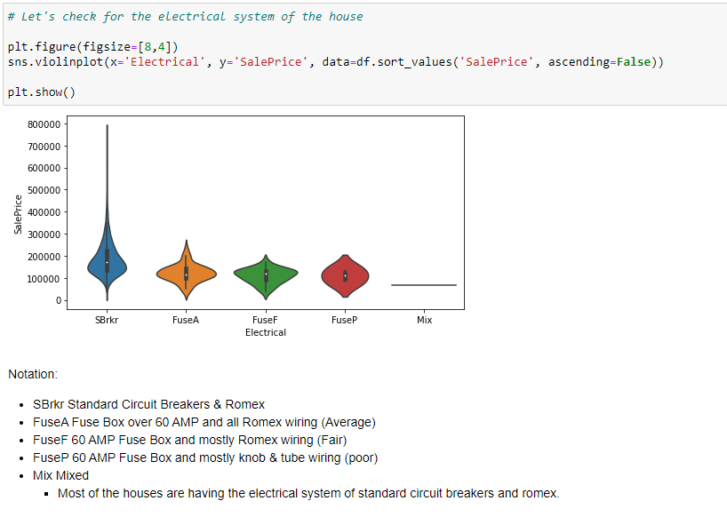

Slide 37
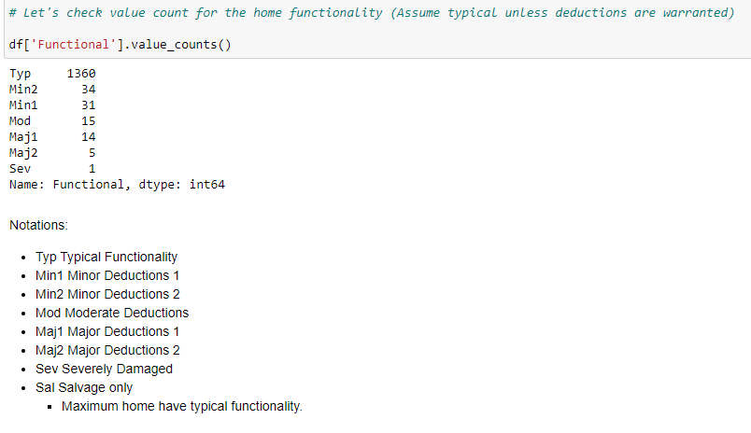

Slide 38
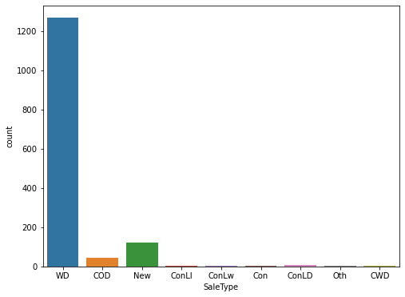
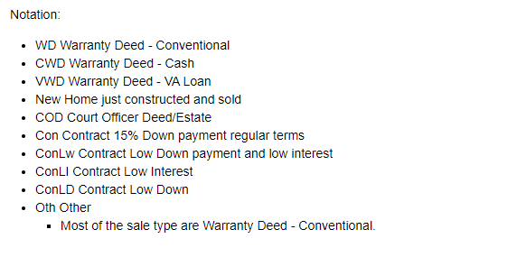

Slide 39
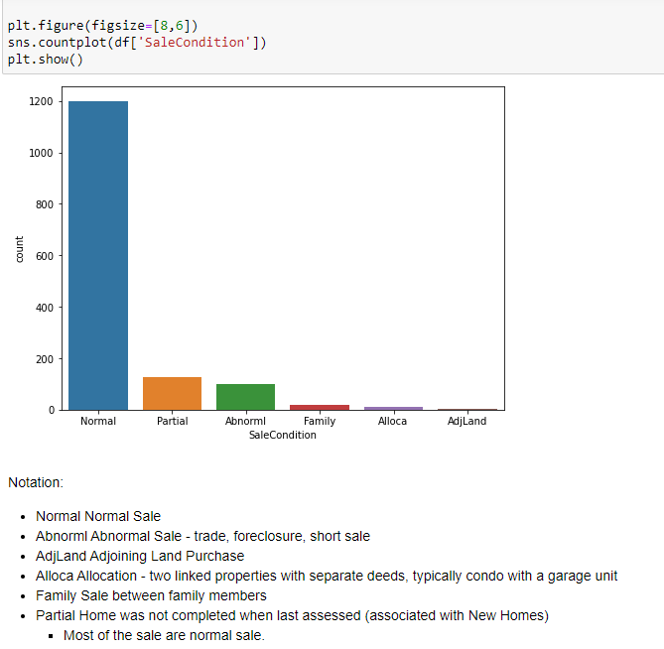

Slide 40

Interpretation of the Results

Slide 41
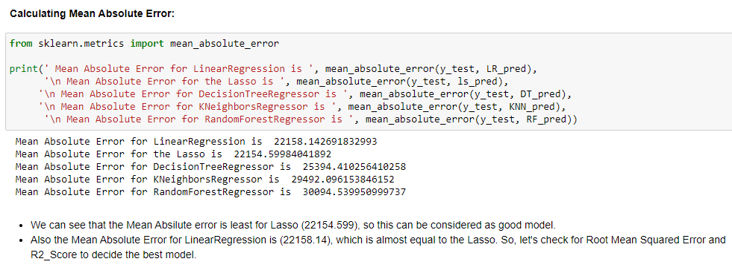
Model Building
Below are the algorithms which we used for training and testing the data:
Linear Regression.
Lasso.
Decision Tree Regression.
K Neighbours Regression.
Random Forest Regression.

Slide 42
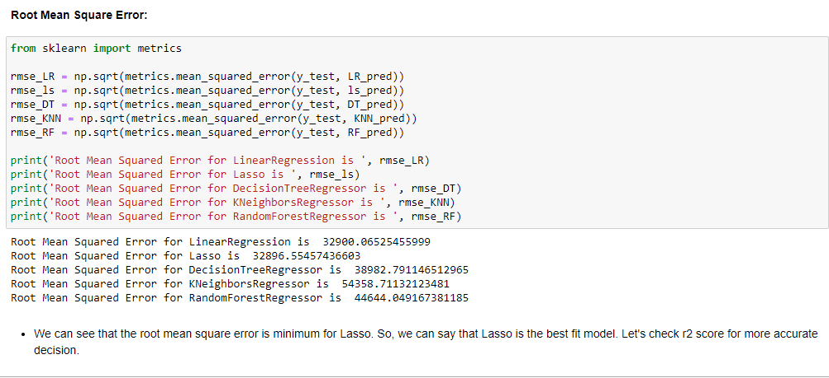

Slide 43
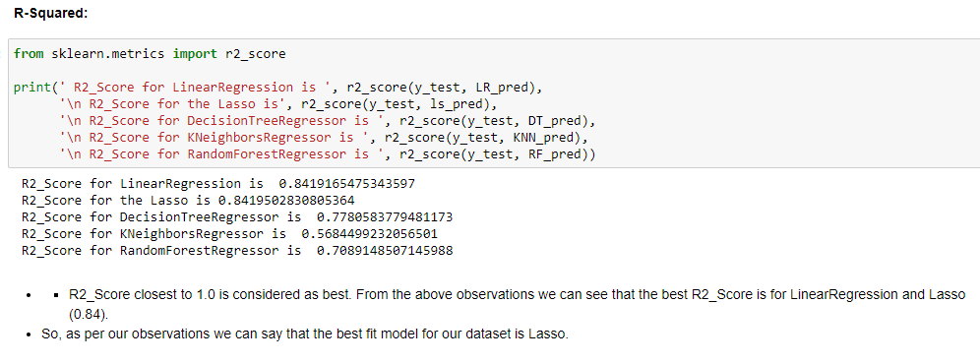

Slide 44
Conclusion

Slide 45

KEY FINDINGS
MS Sub Class seems to have the biggest impact on House Prices, followed by Basement Full Bath and Basement Half Bath.
Other than the Basement related features, Condition 2, Exterior Quality and Lot Area are some of the other important features.

Slide 46
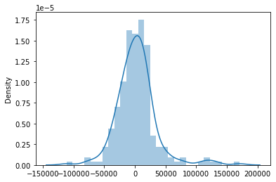
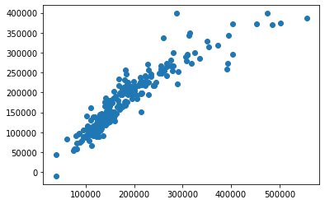
Title
Click here to add the text, the text is the refinement of your thought

Slide 47

THANKS

